Slide 1
Software Quality Assurance
/
Software Quality Engineering
Lecture 1
Naseer Ahmed

Slide 2
SQA - Software Quality Assurance
/
SQE - Software Quality Engineering
Class Participation 35
  Quizzes 20
  Assignments 15
Mid-Term Exam 25
Final Exam 40

Slide 3
Text/Reference Books & Study Materials
Software Quality Engineering: Testing, Quality Assurance and Quantifiable Improvement,
by Jeff Tian, published by Wiley, ISBN 0-471-71345-7, is the required text.
Software Testing and Quality Assurance: Theory and Practice,
by Kshirasagar Naik, Priyadarshi Tripathy
Lecture notes will be posted at the course website on a regular basis.

Slide 4

Introduction

Slide 5
Introduction
What is Software?
IEEE (Institute of Electrical and Electronics Engineers)
definition:
“Software is computer programs, procedures and possibly associated documentation and data pertaining to the operation of a computer system.”
Software is a set of programs, which is designed to perform a well-defined function. A program is a sequence of instructions written to solve a particular problem.
Two major types of Software:
Generic –Stand alone, sold on open market
Customized –For specific customer

Slide 6
What is Software Quality Assurance?

Slide 7
What is Quality?
Quality – developed product meets it’s specification
"Quality is when your customers come back, not your products" – Margaret Thatcher
Conformance to requirements
Fit for customer’s use
Low defect rate (# of defects/unit)
High reliability
Quality is all about meeting the needs and expectations of customers concerning functionality, design, reliability, durability, and price of the product.

Slide 8
What is Assurance?
Assurance is a positive declaration on a product or service. It is all about the product which should work well. It provides a guarantee which would work without any problem according to expectations and requirements.

Slide 9
What is Quality Assurance?
Quality Assurance is also known as QA Testing. QA is defined as an activity to ensure that an organization is providing the best product or service to the customers.
Software Quality Assurance seems it is all about evaluation of software based on functionality, performance, and adaptability; however software quality assurance goes beyond the quality of the software, it also includes the quality of the process used to develop, test and release the software.
Software Quality assurance is all about the Software Development lifecycle that includes requirements management, software design, coding, testing, and release management.

Slide 10
What is Quality Assurance?
Quality Assurance is the set of activities that defines the procedures and standards to develop the product.
Quality Assurance is a systematic way of creating an environment to ensure that the software product being developed meets the quality requirements.
Quality Assurance focuses on process standard, projects audit, and procedures for development. QA is also known as a set of activities designed to evaluate the process by which products are manufactured.
QA focused on improving the processes to deliver Quality Products.

Slide 11
Quality Attribute of a software
The following six characteristics can define the quality of the software:
Functionality
Quality of software is defined as how effectively the software interacts with other components of the system. The software must provide appropriate functions as per requirement, and these functions must be implemented correctly.
Reliability
It is defined as the capability of the software to perform under specific conditions for a specified duration.

Slide 12
Quality Attribute of a software
Maintainability
Maintainability is also one of the significant factors to define the quality of the software. It refers to identify the fault and fix in the software. It should be stable when the changes are made.
Portability
Portability of the software, defined as how easily a system adapts to changes in the specifications. Quality of the software is also determined by the portability of the system how easy it is to install the software and how easy it is to replace a component of the order in a given environment.

Slide 13
Quality Attribute of a software
Usability
Usability of software is defined as its ease of use. Quality of the software is also identified as how easily a user can understand the functions of the software and how much efforts are required to follow the features.
Efficiency
The efficiency of the software is dependent on the architecture and coding practice followed during development.

Slide 14
Software Quality Assurance components
Software Quality Assurance has six classes of components.
Pre-project Plan
Pre-project Plan ensures that the resources required for project, schedule, and budget should be clearly defined. Plan for development and ensuring quality has been determined.
Components are as:
Required Resources (Hardware and Human resources)
Development plan
Schedules
Risk evaluation
Quality plan
Project methodology

Slide 15
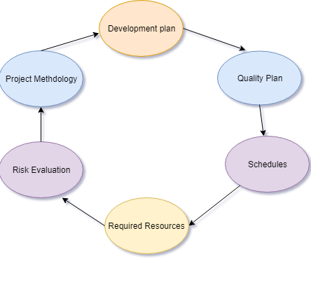
Software Quality Assurance components
Pre-project Plan

Slide 16
Software Quality Assurance components
Software Quality Assurance has six classes of components.
Project lifecycle component
A project lifecycle usually comprised of two stages:
Development Stage
In the Development Stage Component, Software Quality Assurance help to identify the design and programming errors. Its Components are divided into the following sub-classes: Reviews, Expert Opinions, and Software Testing.

Slide 17
Software Quality Assurance components
Project lifecycle component
Operation Maintenance Stage
In Operation Maintenance Stage, the Software Quality Assurance components include the Development lifecycle component along with specialized components whose aim is to improve the maintenance tasks.

